Slide 1


DOCTOR APPOINTMENT MANAGEMENT SOFTWARE
Submitted by
Group 06
Abhilipsa Swain
Ambati Srivani
Gondesi Deepthi
Jasmeet Kaur
R.S.S.V Uma Sri

Slide 2


Content
Introduction
About Project
Flowchart
Tools
Output
Conclusion

Slide 3
Introduction
This process is intended to implement the doctor appointment management software.
This DAMS can be easily used by all the users irrespective of their age. A Doctor Appointment System is a self-service tool for booking appointments.

Slide 4
About Project
The doctor appointment management software is made in such a way that it will have a login page from where the admin can login into the database.
There will be sub menus like -creation for doctor ,creation for patient, create an appointment, display, search, and exit.
So, in the patient part we will receive a unique id for a particular patient and based on the illness the doctor will be appointed as per the availability.

Slide 5
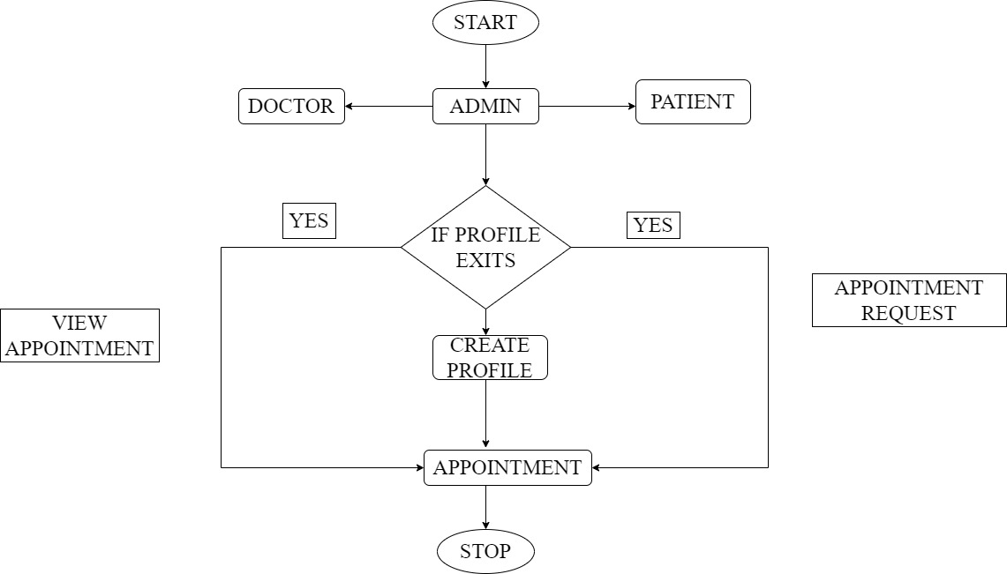

Flowchart

Slide 6
Tools
Ubuntu Linux platform.
C language.
Makefile is used for compilation.
Splint is used for static analysis.
Valgrind to used for static compiler
GCC is an optimizing compiler.
Draw.io is used for illustrated representation.
Gcov is used to check code coverage

Slide 7
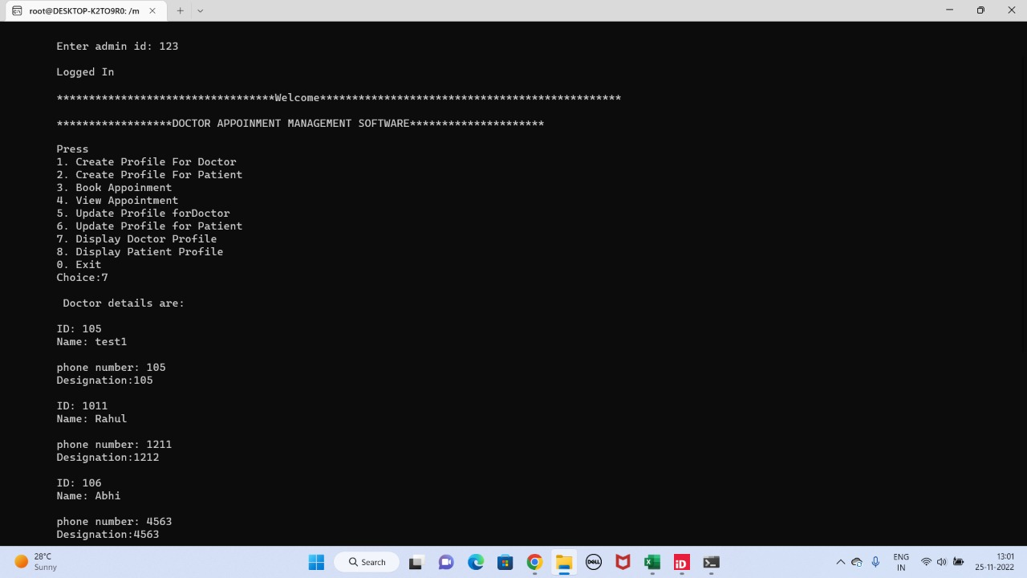
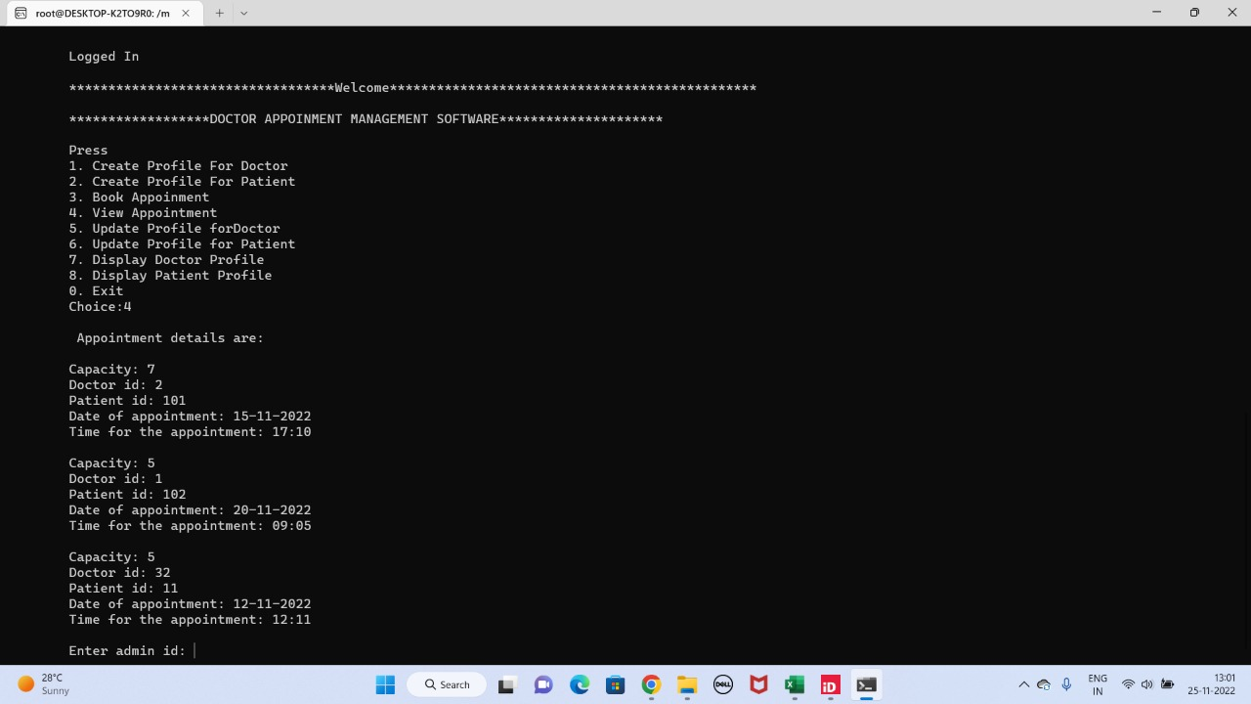
Outputs

Slide 8

Conclusion
This project is to build an appointment management software for the doctor. Doctor can Search for Patient. check his booking is made for the entire day not and check if the appointment for the patient is completed or not.
Here the patient can get appointed to the doctor for a particular slot based on their illness and based on the availability of the doctor.
Admin panel has the access to both the doctor and the patient panel. It can check for the doctor's schedule for that particular day. It can search for the patients slot, make a new booking and also check if the appointment for the patient is completed or not.

Slide 9
THANK YOU

